Slide 1
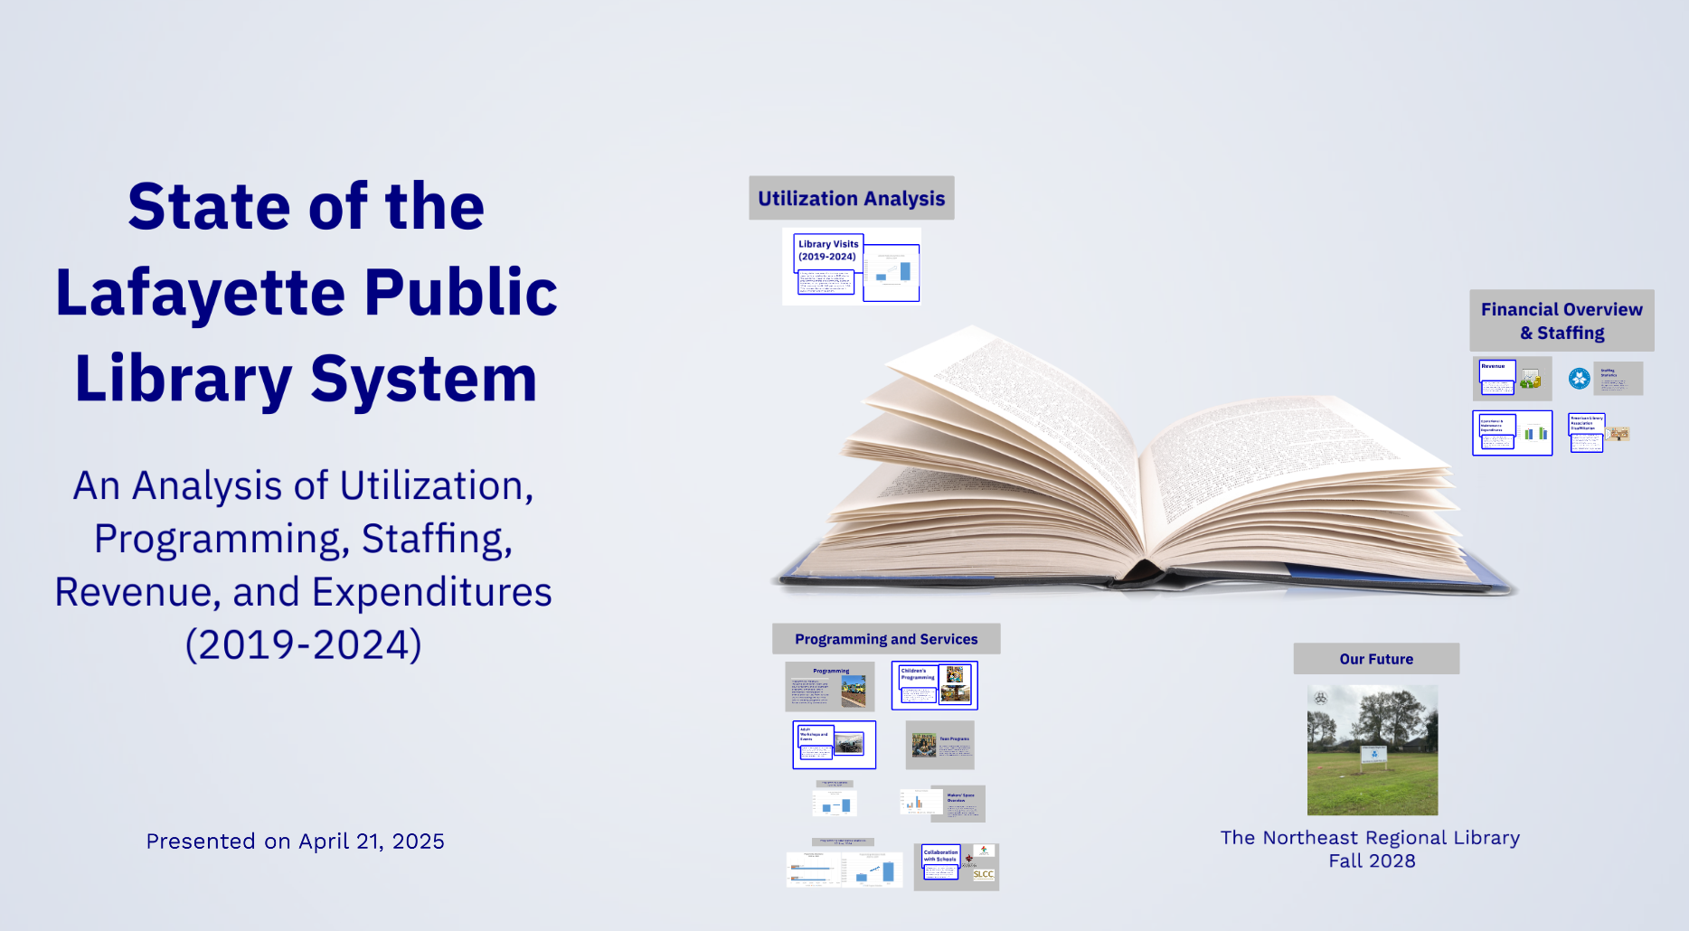



September 15, 2025

Slide 2
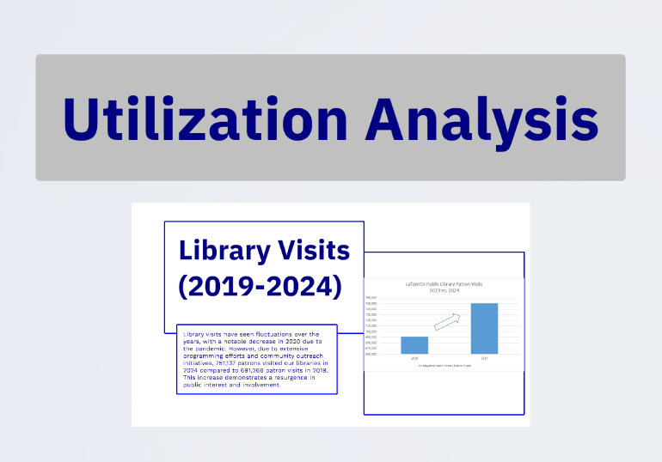

Slide 3
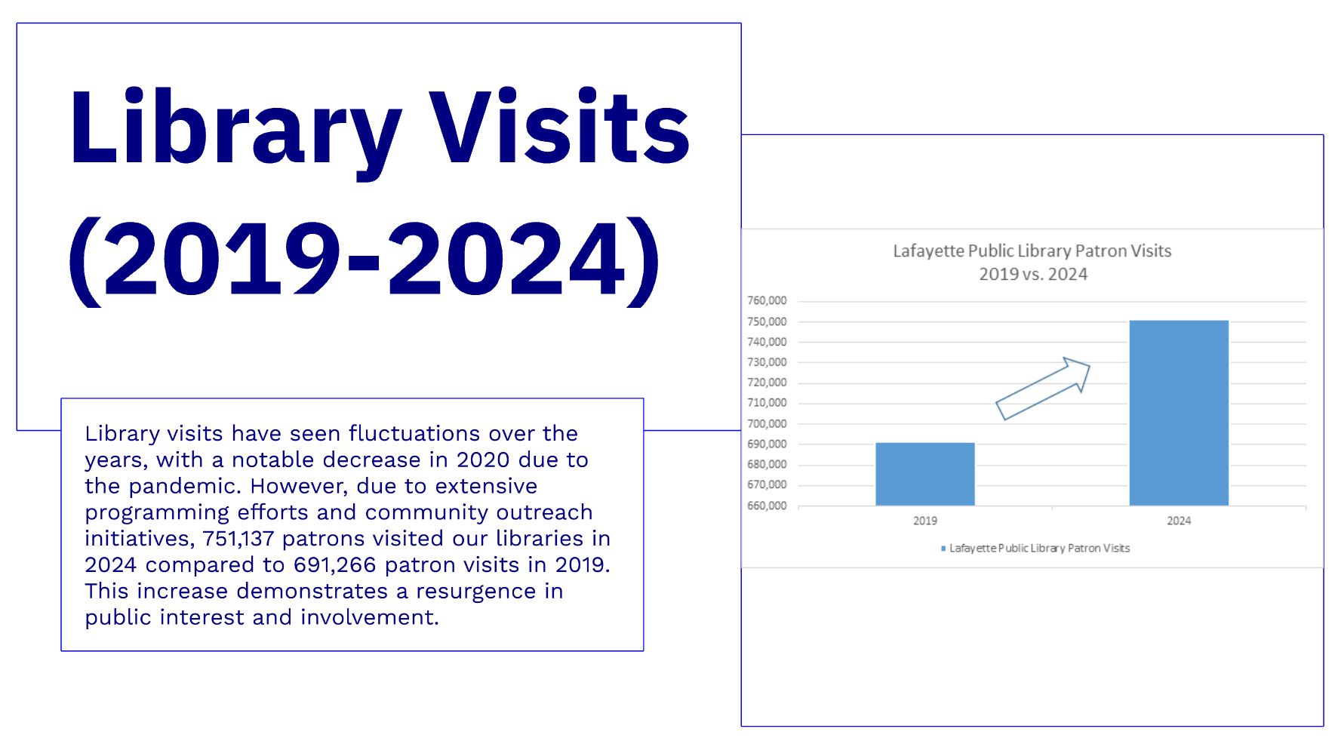

Slide 4
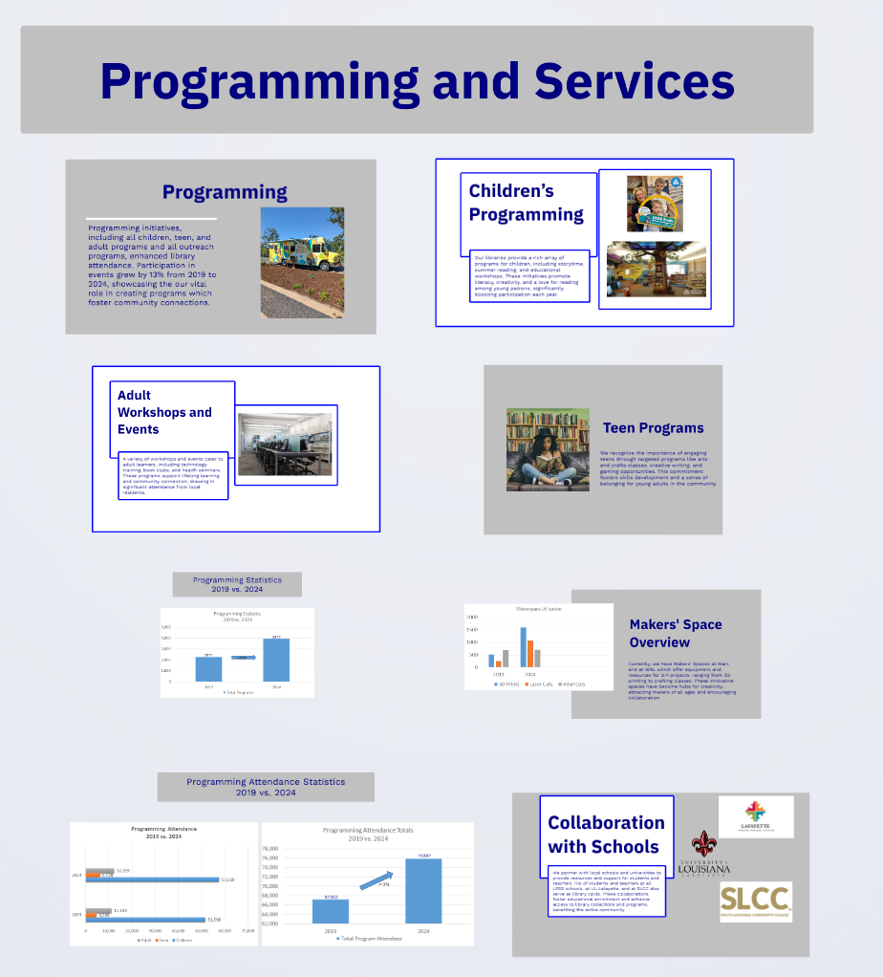

Slide 5
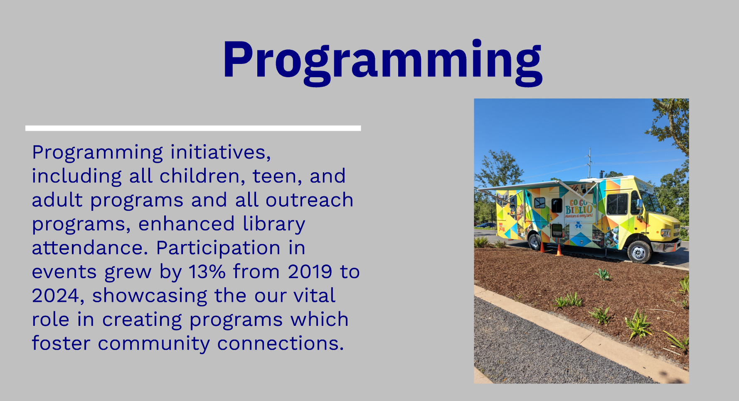

Slide 6
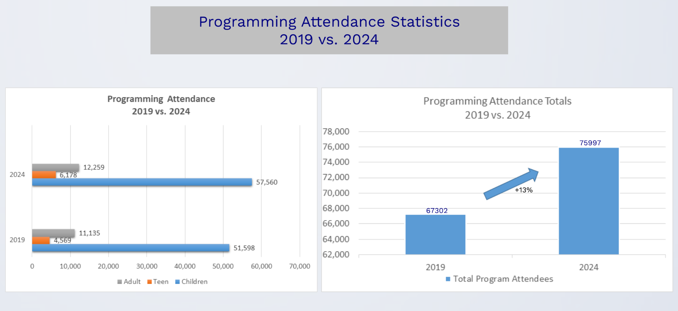

Slide 7
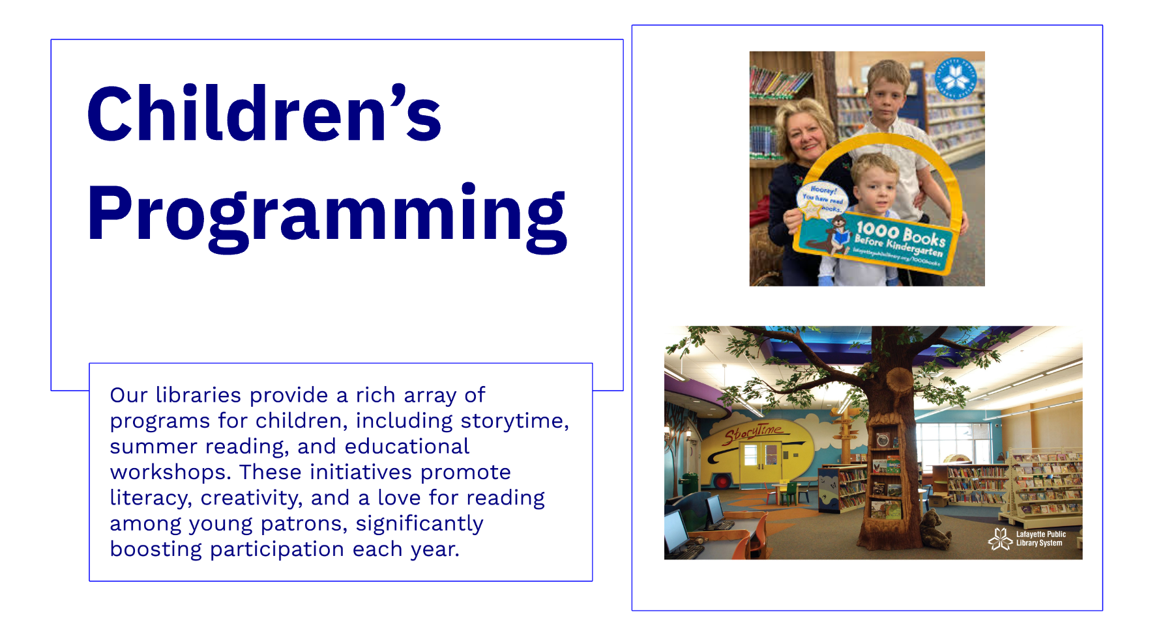

Slide 8
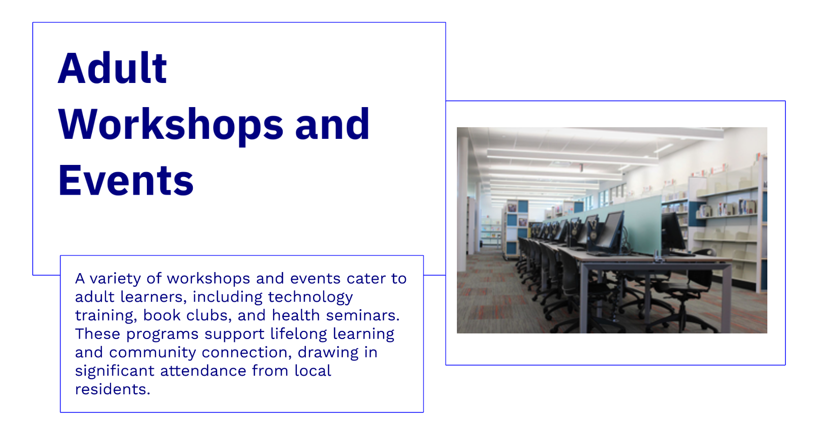

Slide 9
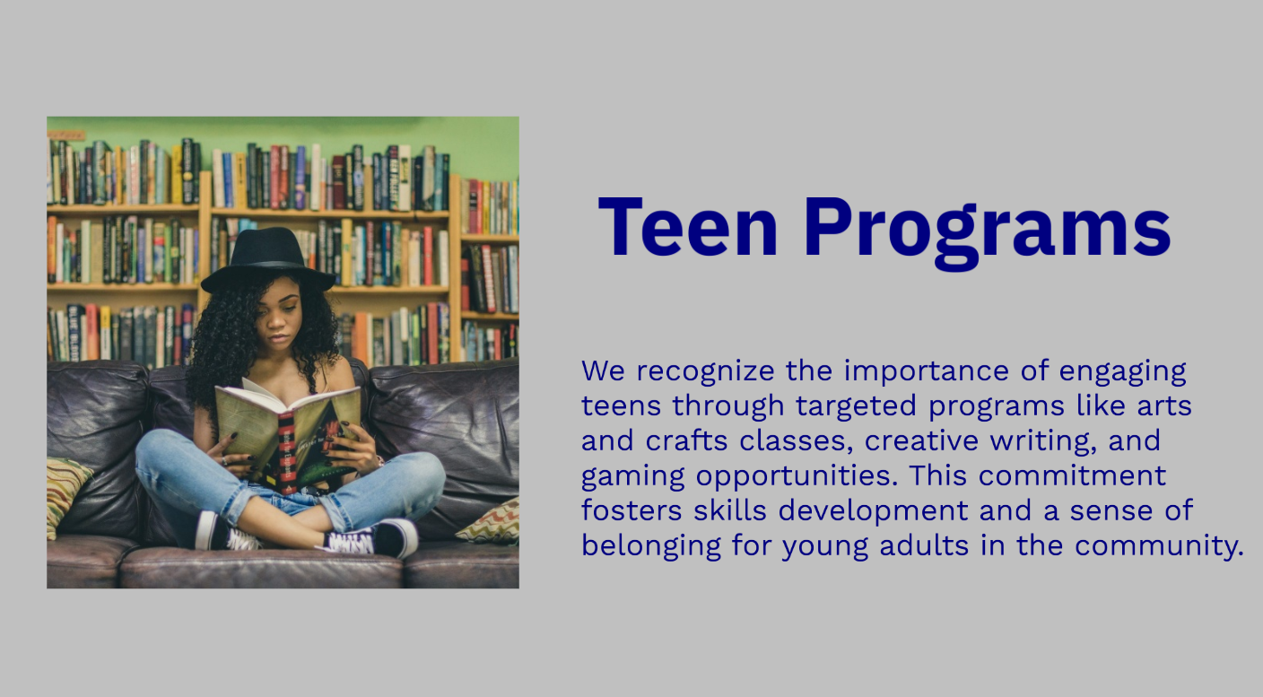

Slide 10
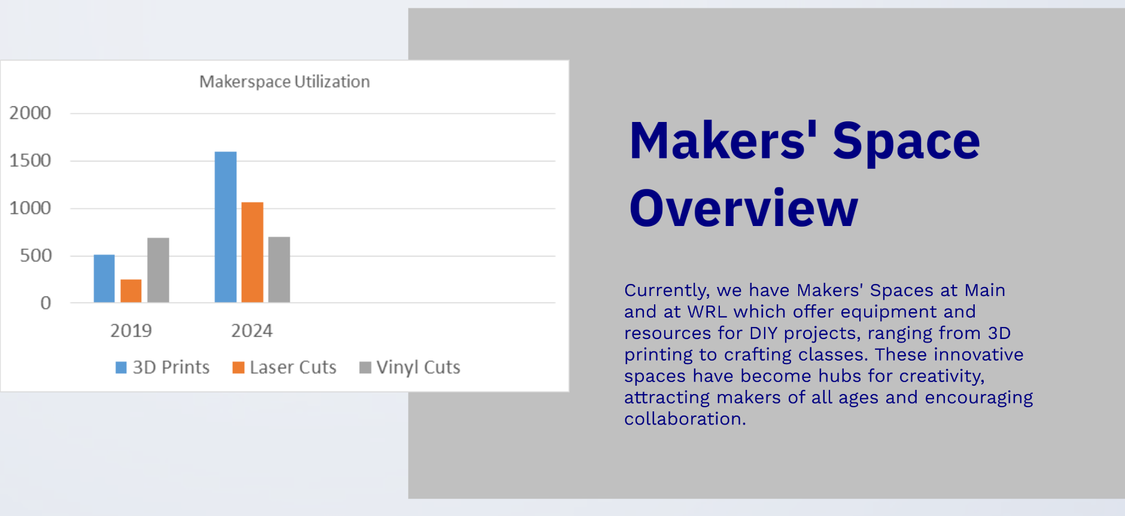

Slide 11
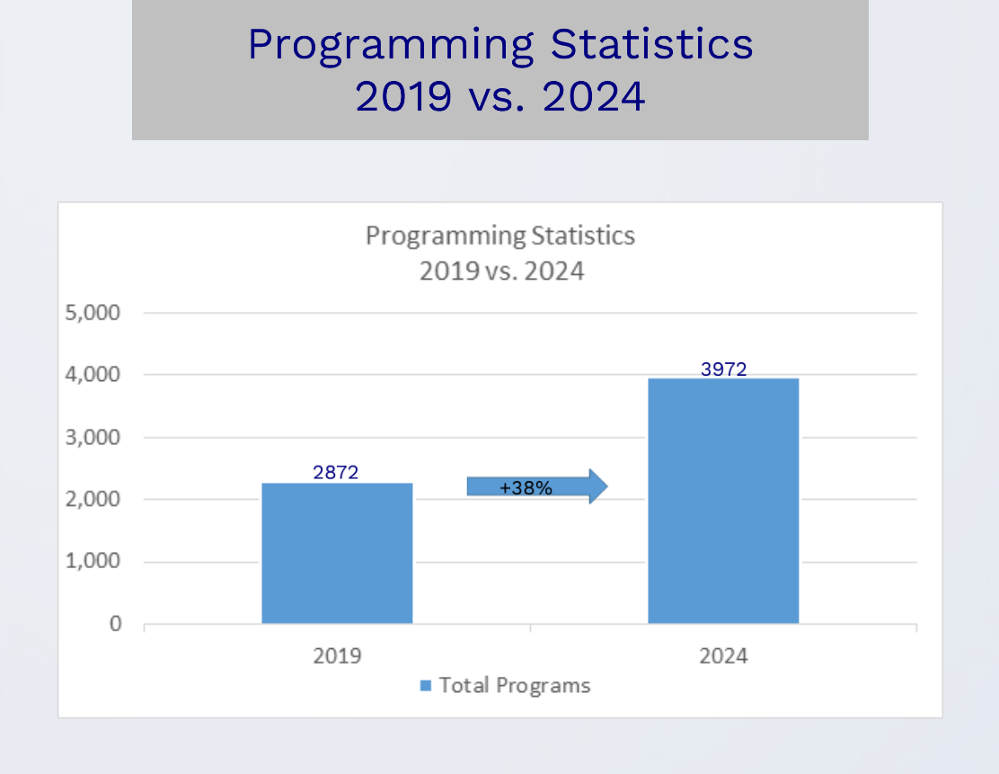

Slide 12
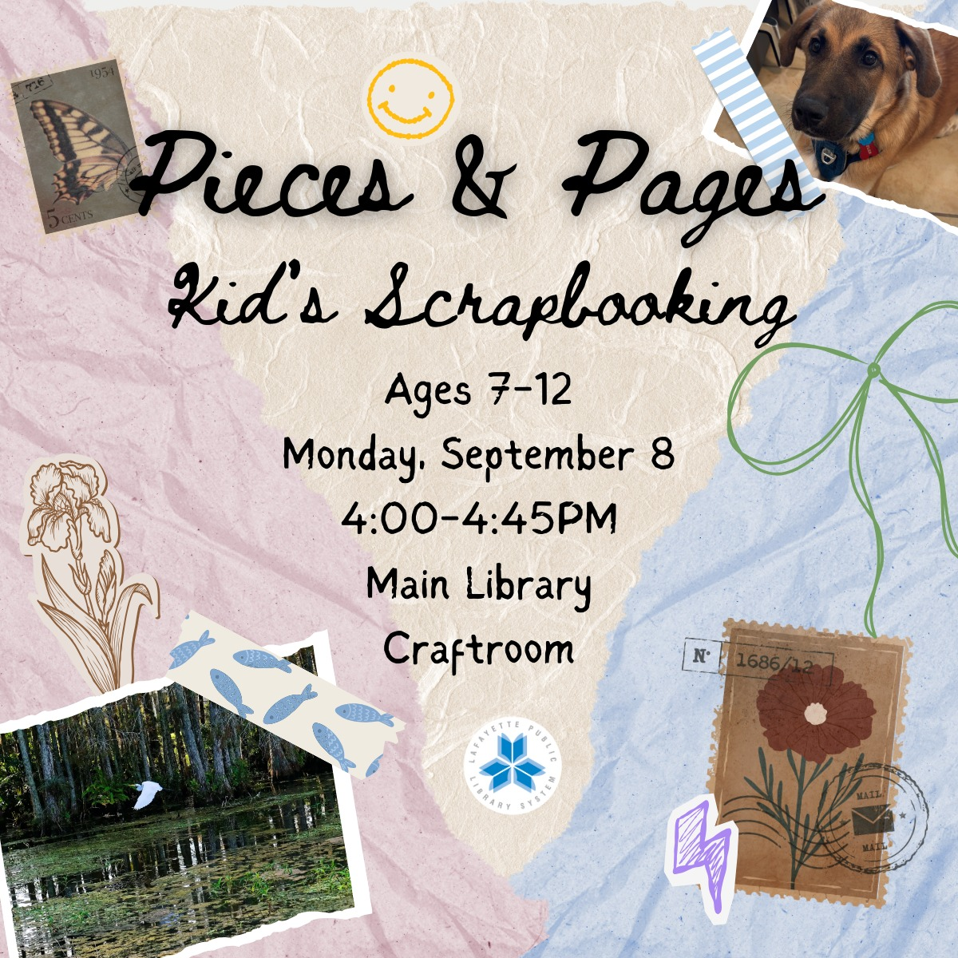
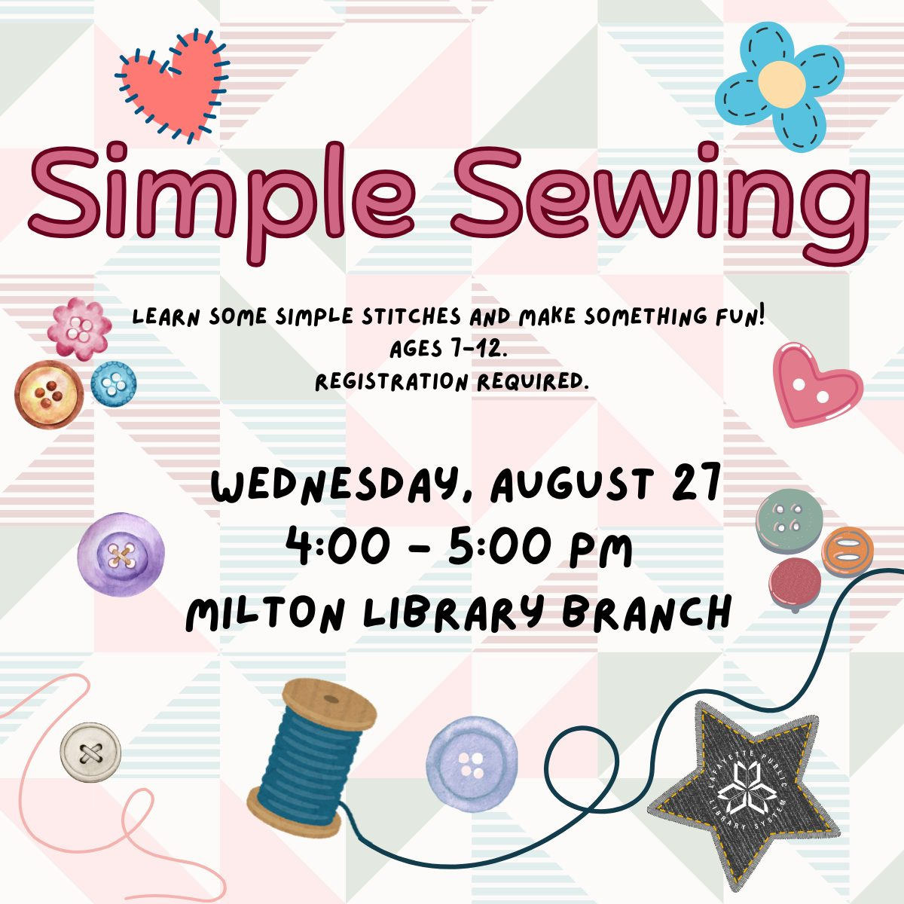






Slide 13

In 2024, 3,972 programs were offered throughout the 8 branches of the Lafayette Public Library system.
Adult Programs Offered:
Fencing
Line Dancing
Charcoal Painting
Mah Jongg Lessons
Genealogy Programs
Plantapalooza!
Teen Programs Offered:
Snack Attack
Teen Artlab
Beaded Succulents Craft
Diamond Painting
Fantasy Map Making
Children’s & Family Programs Offered:
Little Artists
Dinovember Bash
Happy Noon Year!
Let’s Make Music!
Beginners Crocheting
Read with a Ranger
Makerspace Programs Offered:
Laser Cutting 101
3D Printing 101
Grab & Go Craft Kits
“Stained Glass” Bird project
Fall Leaves Earring project
Computer Classes Offered:
Computers for Beginners
Google Docs Basics
Smartphones for Beginners
Photo Editing for Beginners
Canva Design Basics

Slide 14



Collaboration
with Schools
All Lafayette Parish School System, UL Lafayette, and South Louisiana Community College students, faculty, and staff IDs serve as library cards. This collaboration fosters educational enrichment and enhances access to all Lafayette Public Library collections, programs, and services, benefiting the entire community.

Slide 15
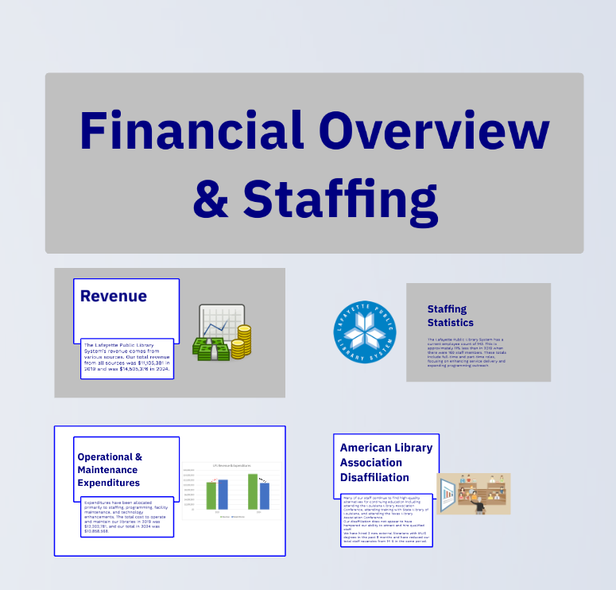

Slide 16
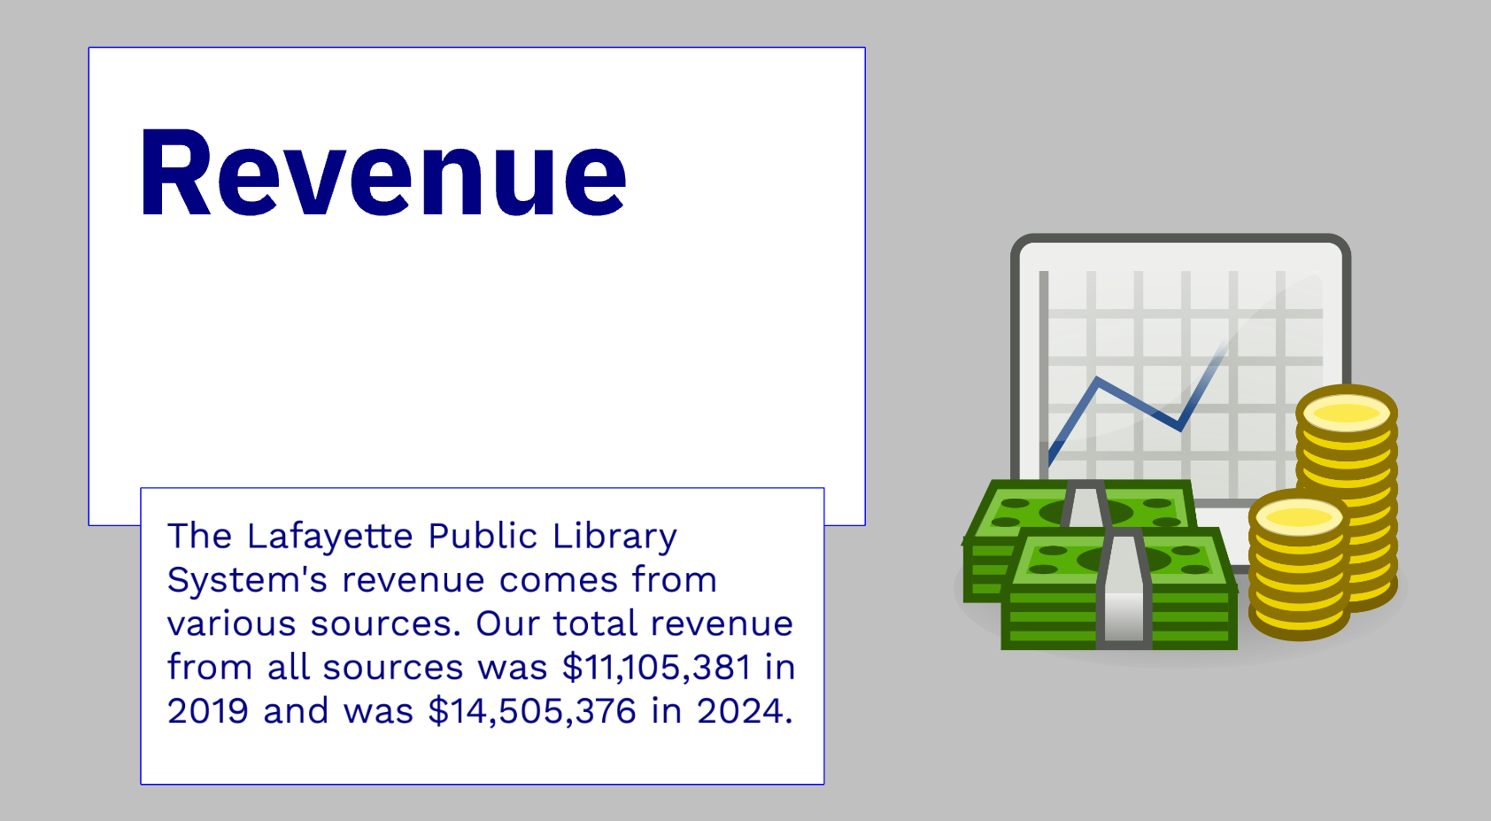

Slide 17
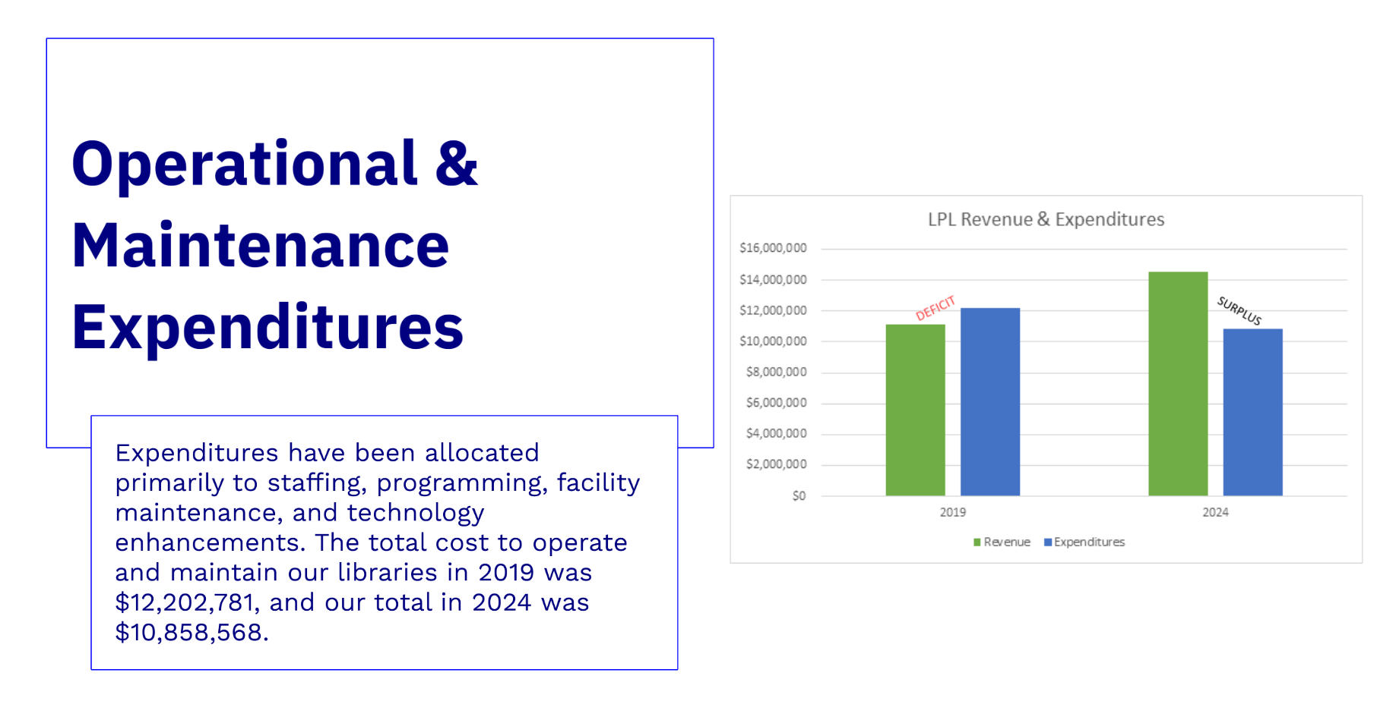

Slide 18
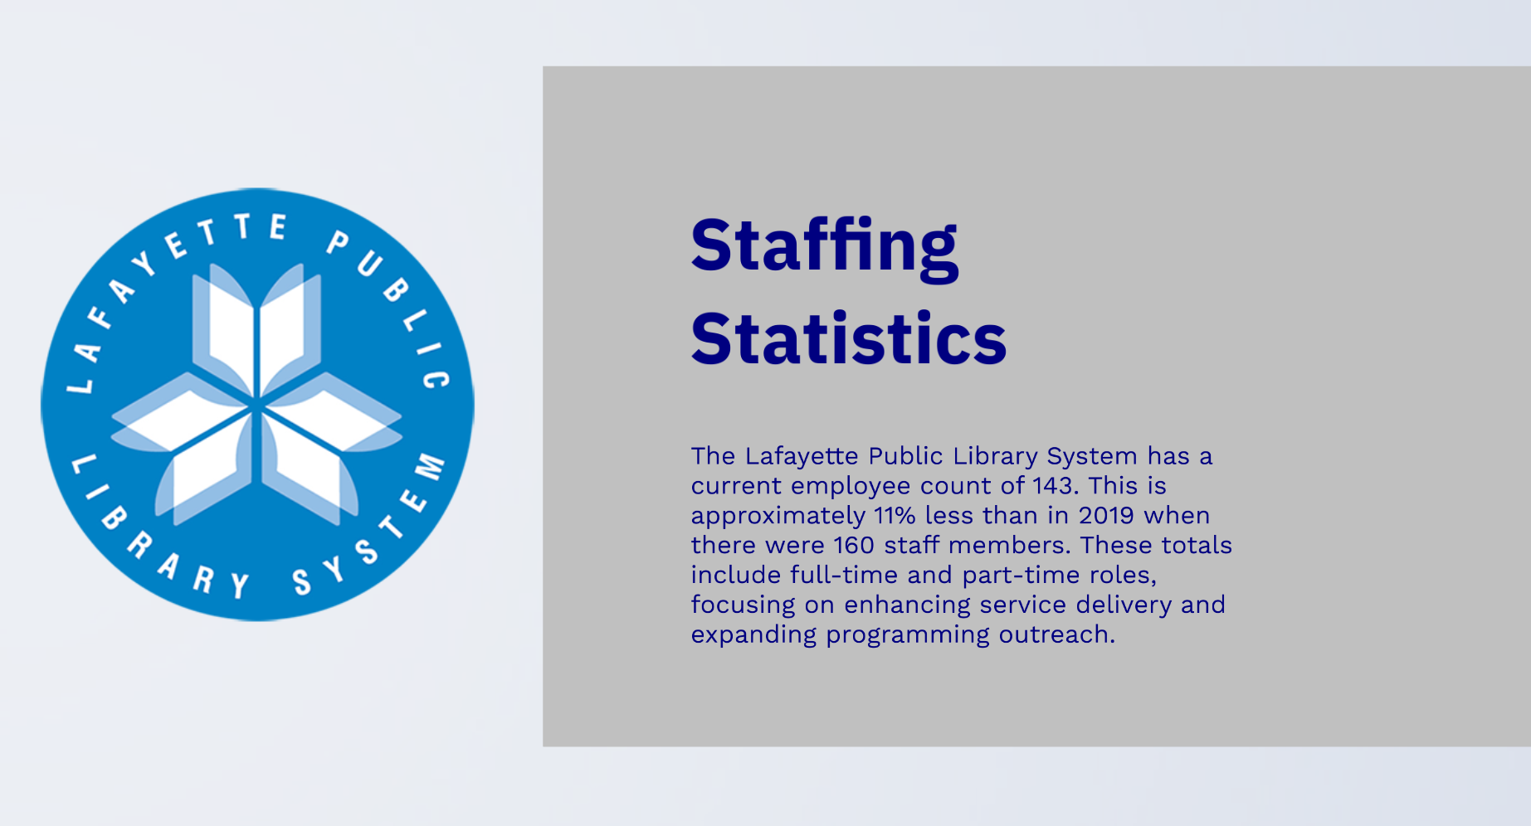

Slide 19
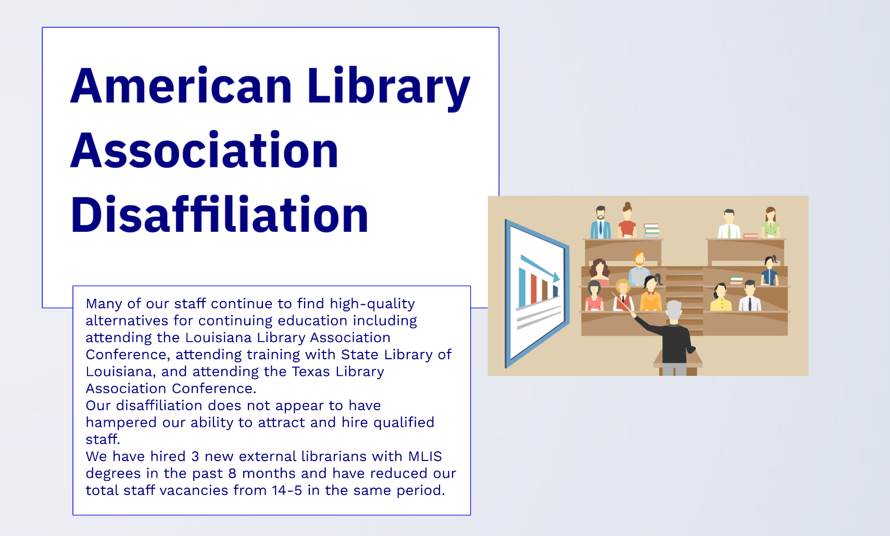
Many of our staff continue to find high-quality alternatives for continuing education including attending the Louisiana Library Association Conference, State Library of Louisiana workshops, and the Texas Library Association Conference.
Our disaffiliation with the American Library Association does not appear to have hampered our ability to attract and to hire qualified staff.
We have hired 3 new external librarians with MLIS degrees in the past 11 months and have reduced our total staff vacancies from 14-5 in that same period.

Slide 20

September 15, 2025

Slide 21
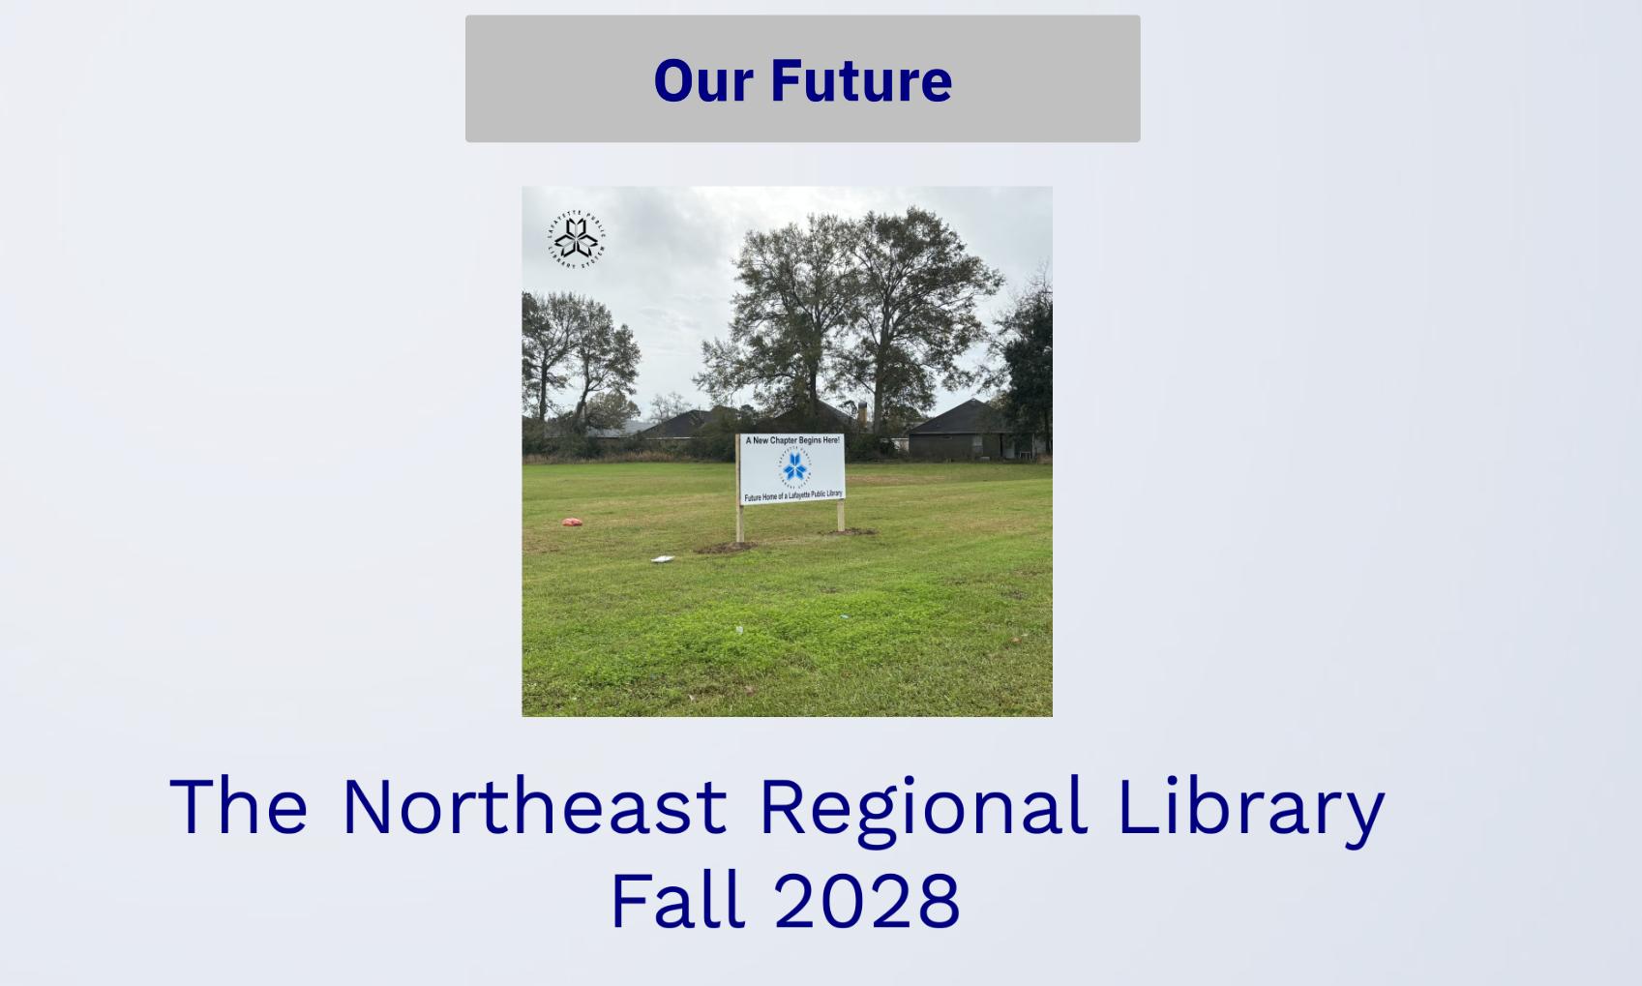

Slide 22

SUMMARY
Our overall patron visits and programming totals have increased.
Our available budget, partnered with financially prudent management, has resulted in increased spending for our programs, renovations for the South Regional Library and for the North Regional Library, and for the future construction of the Northeast Library.
We have been able to hire and to retain highly qualified staff who provide outstanding programming and services to the citizens of Lafayette Parish.
Through community outreach and partnerships, we have and will continue to provide all citizens of Lafayette with equitable access to our collections, programs and services.

Slide 23
September 15, 2025

